Slide 1
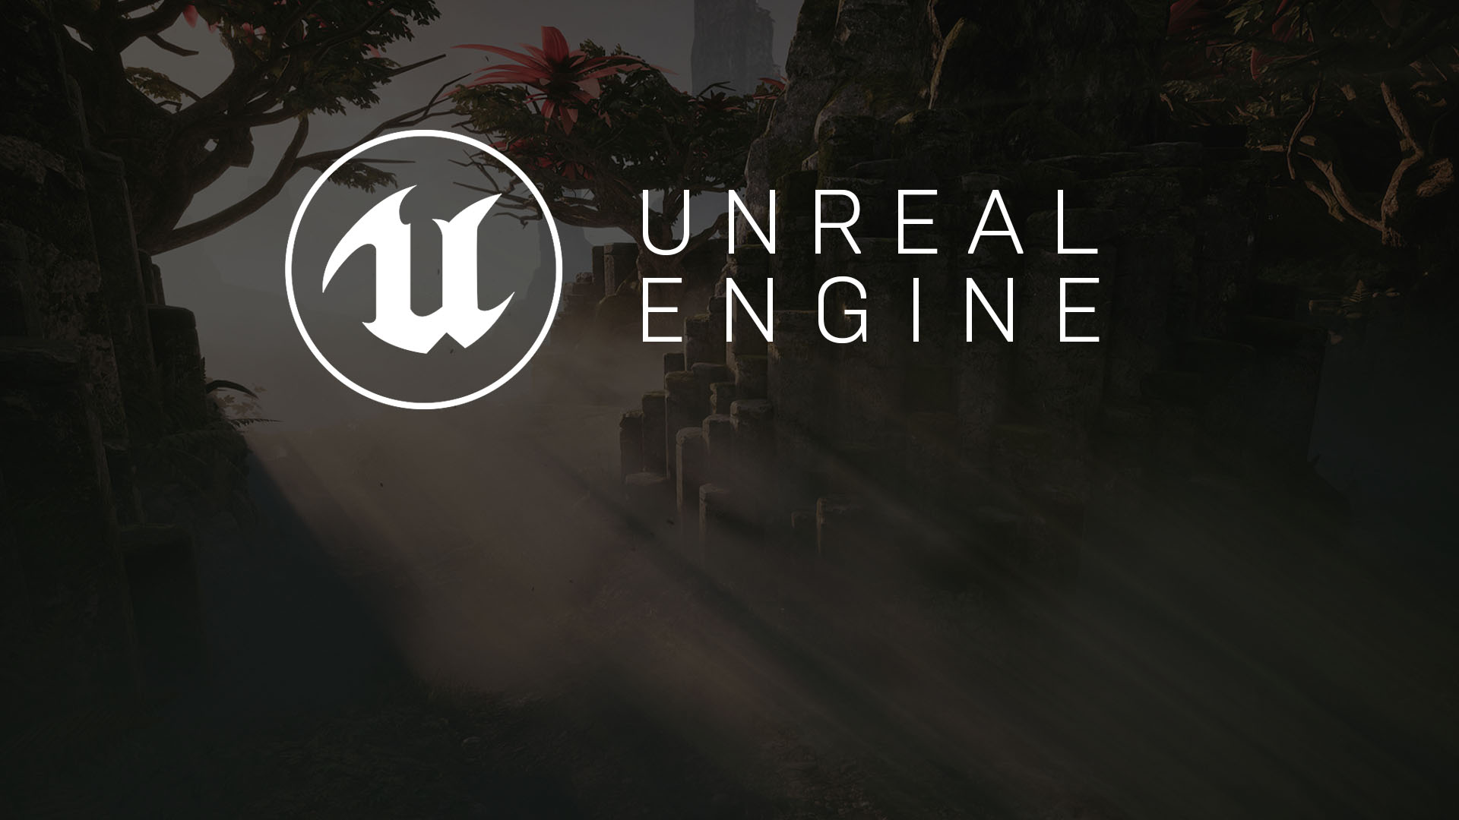
Developing AI in Games
Understanding Artificial Intelligence
and Artificial Stupidity

Slide 2
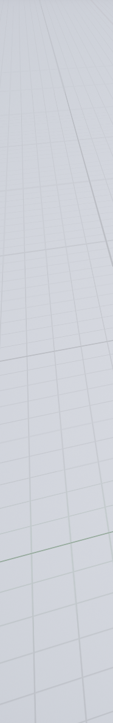
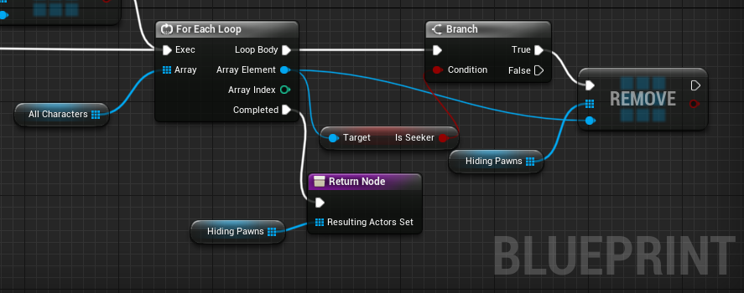
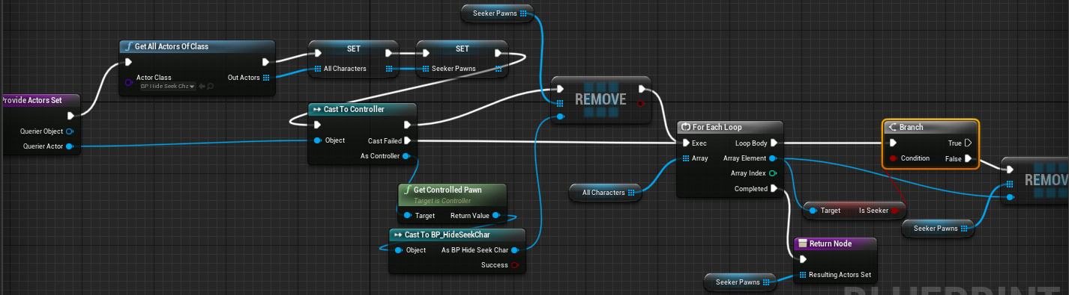

EQS QUERY CONTEXTS
Add a new class derived from EnvQueryContext_Blueprintbase and name it to EQC_Seeker.
This query will compute the active list of seekers.
Duplicate and rename the asset to EQC_Hiding.
Just change the part where isSeeker branch goes to false.

Slide 3

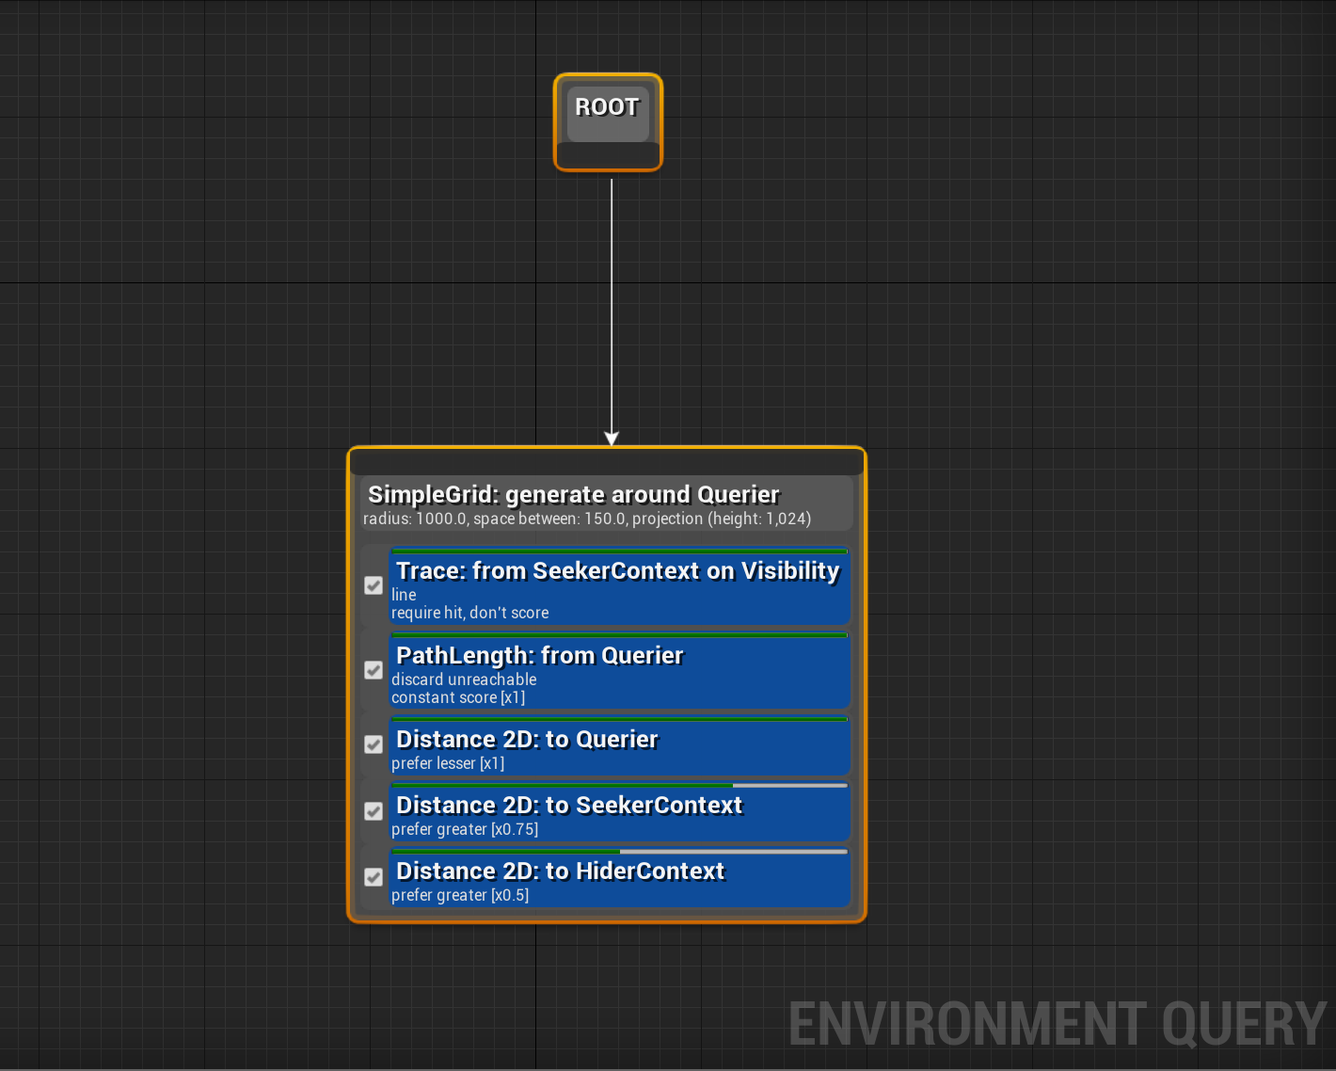
Hide and Seek AI: EQS
The EQS Query does the following:
Traces between the point and any known “Seeker” (the term we used for the searching team in Hide and Seek)
Discards any unreachable points in the grid
Evaluates the distance to the player (prefers closer points)
Evaluates the distance from any Seeker (prefers farther points)
Evaluates the distance to any other “hiders” to look for separate hiding places
EQS Setup for finding a hiding spot

Slide 4
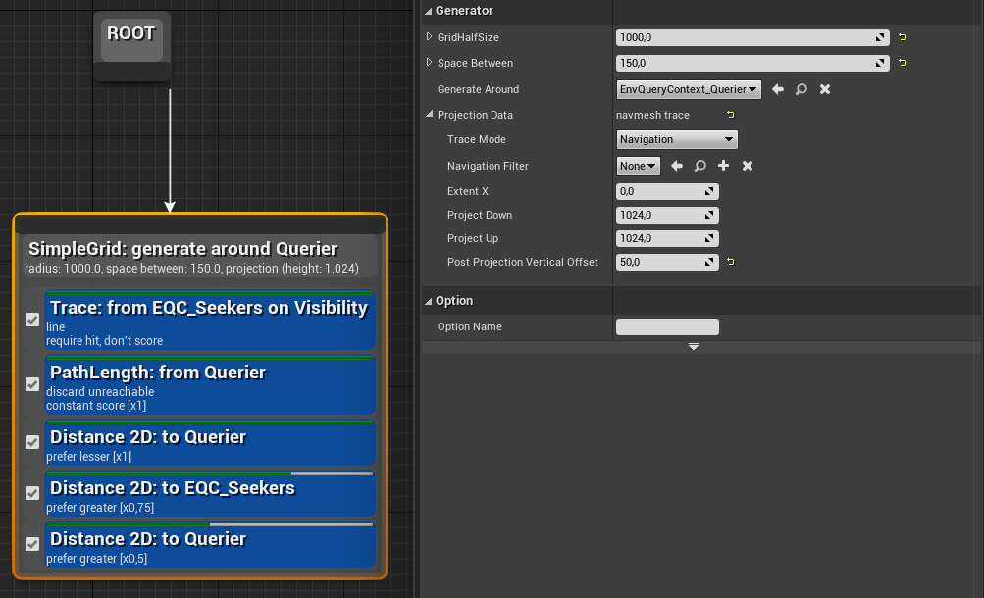
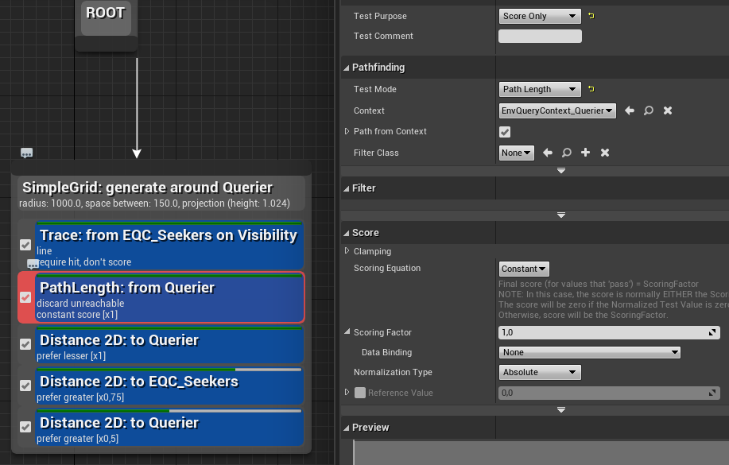
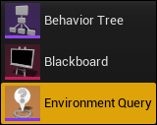
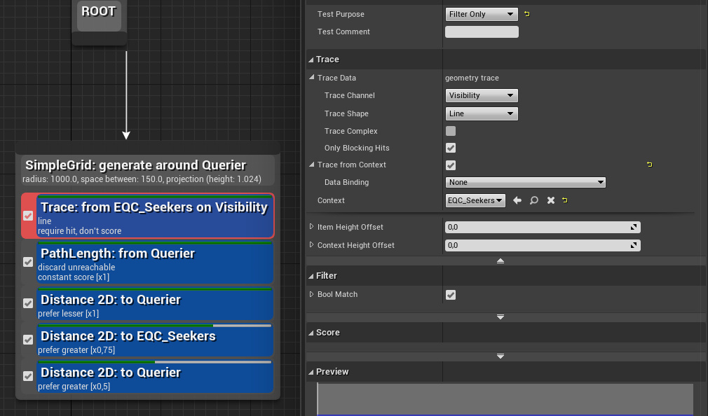
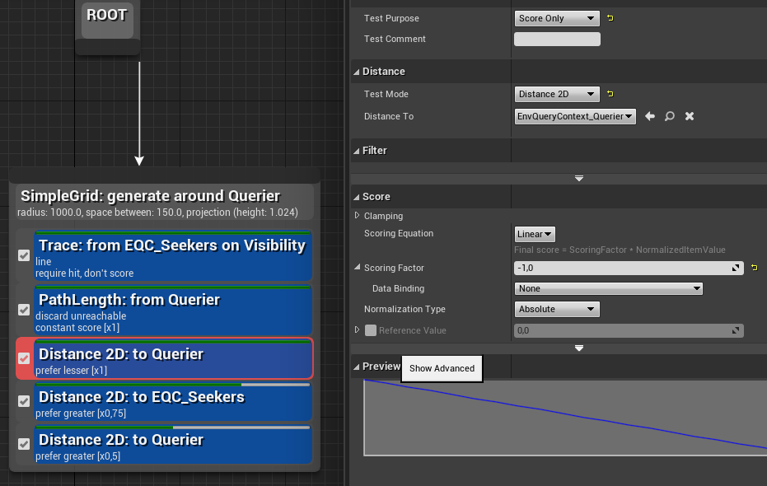
EQS QUERY (EQS_HidingSpot)
Add a new Environment Query from Artificial Intelligence context menu from Right Click «Create Advanced Asset» menu.

Slide 5
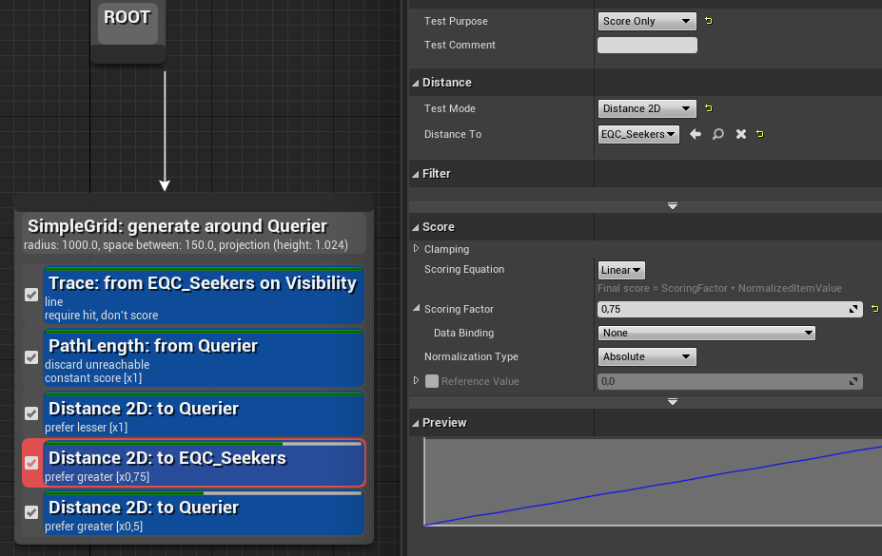
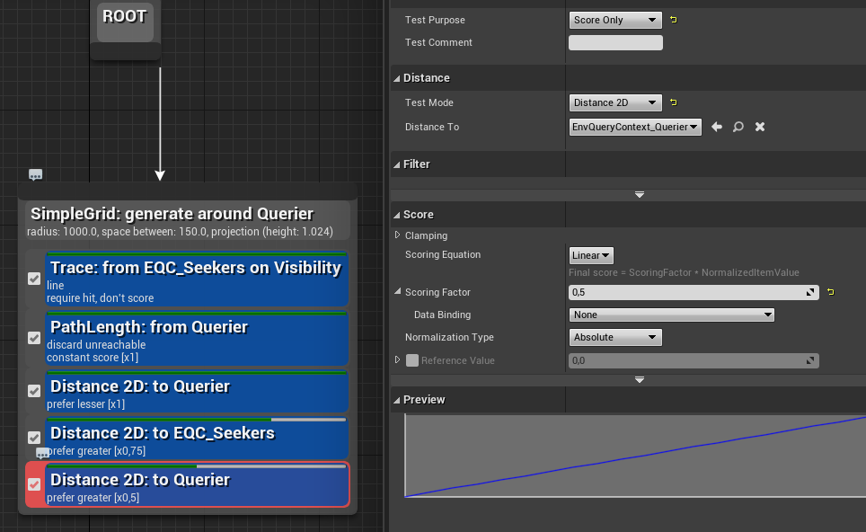
EQS QUERY

Slide 6
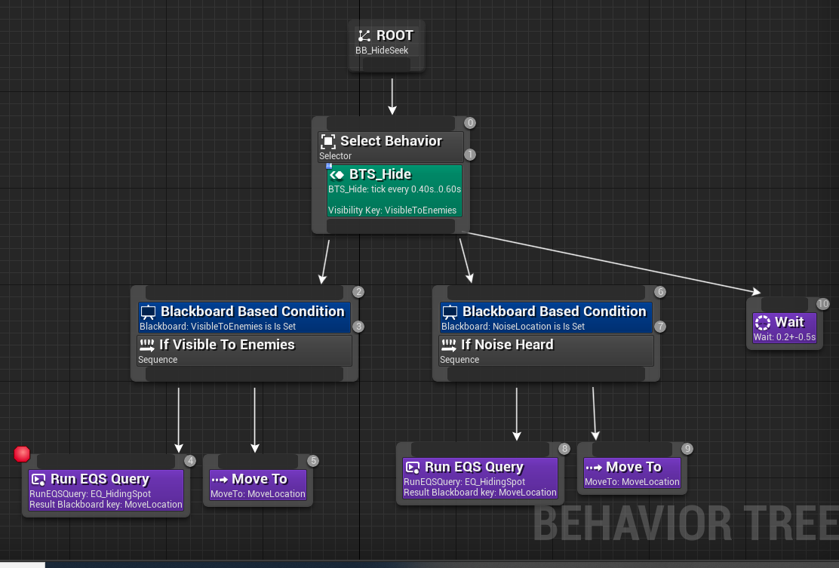
HIDING BEHAVOUR TREE

Slide 7
Navigation
Processing and Interpreting the Important Elements of the World

Slide 8
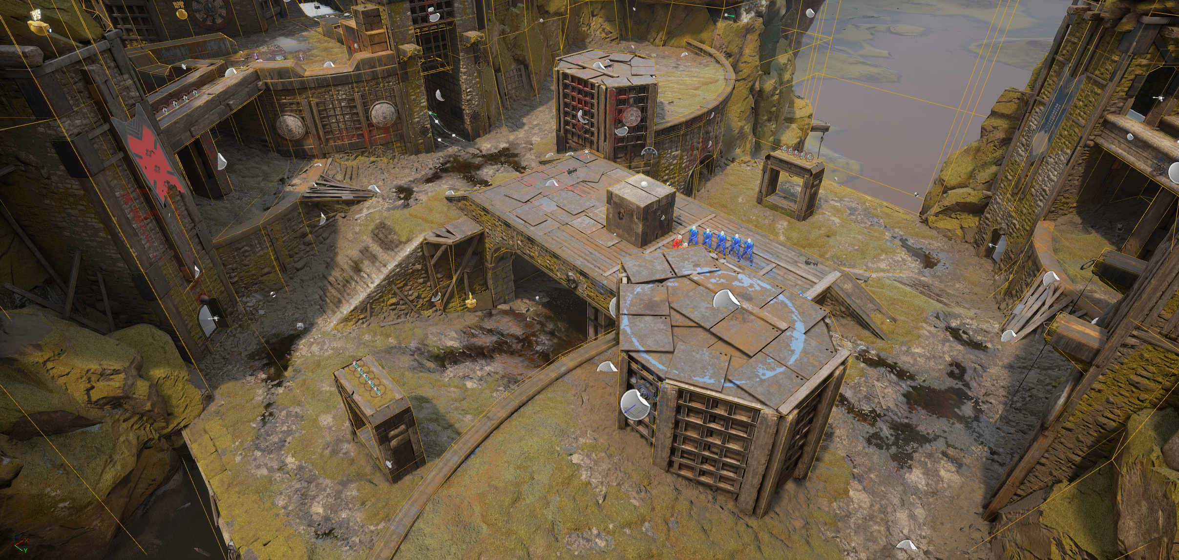
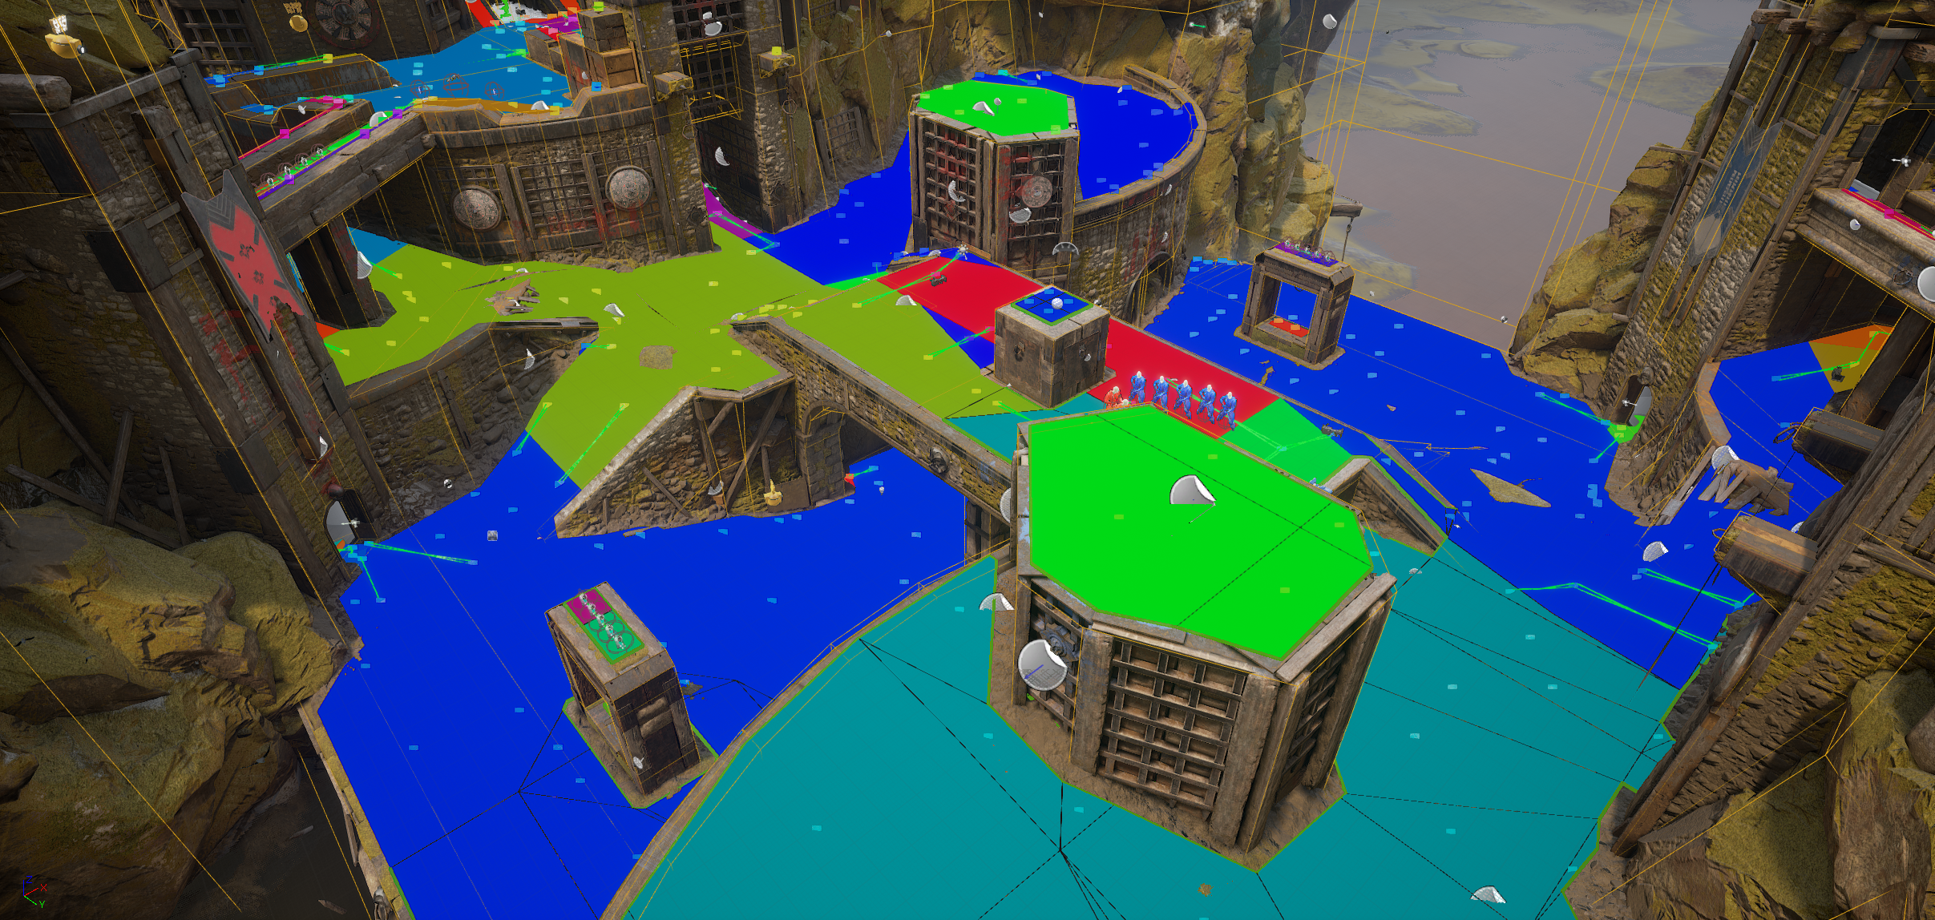
Navigation Overview
An AI character can only move through the world if it knows how. Unlike a human being, who can view and perceive an environment, AI requires the environment to be simplified into a format that can be more easily processed.
The process of identifying a path through an area is known as Pathfinding. The three most common types of navigation systems are Navigation Points, Navigation Grids, and Navigation Meshes.

Slide 9
How does pathfinding work?
Dijkstra Pathfinding
A* Pathfinding
Every node in a search graph knows what other nodes are connected to it. The Dijkstra pathfinding algorithm begins at the starting node in a graph and expands to any connected nodes if the distance to reach it is less than the currently known distance to reach it or if the node has never been traveled to. It expands through each node until the finishing point is found, at which point the path is discovered by walking back from the finishing node through to the surrounding nodes with the lowest score until the path back to the first node has been formed.
The A* algorithm operates in the same way as a Dijkstra algorithm; however, it also includes the weighting of a heuristic in determining the score of a given node. This heuristic could be distance or a distance value modified by the type of ground between the two points.
For more information:
https://www.redblobgames.com/pathfinding/a-star/introduction.html

Slide 10
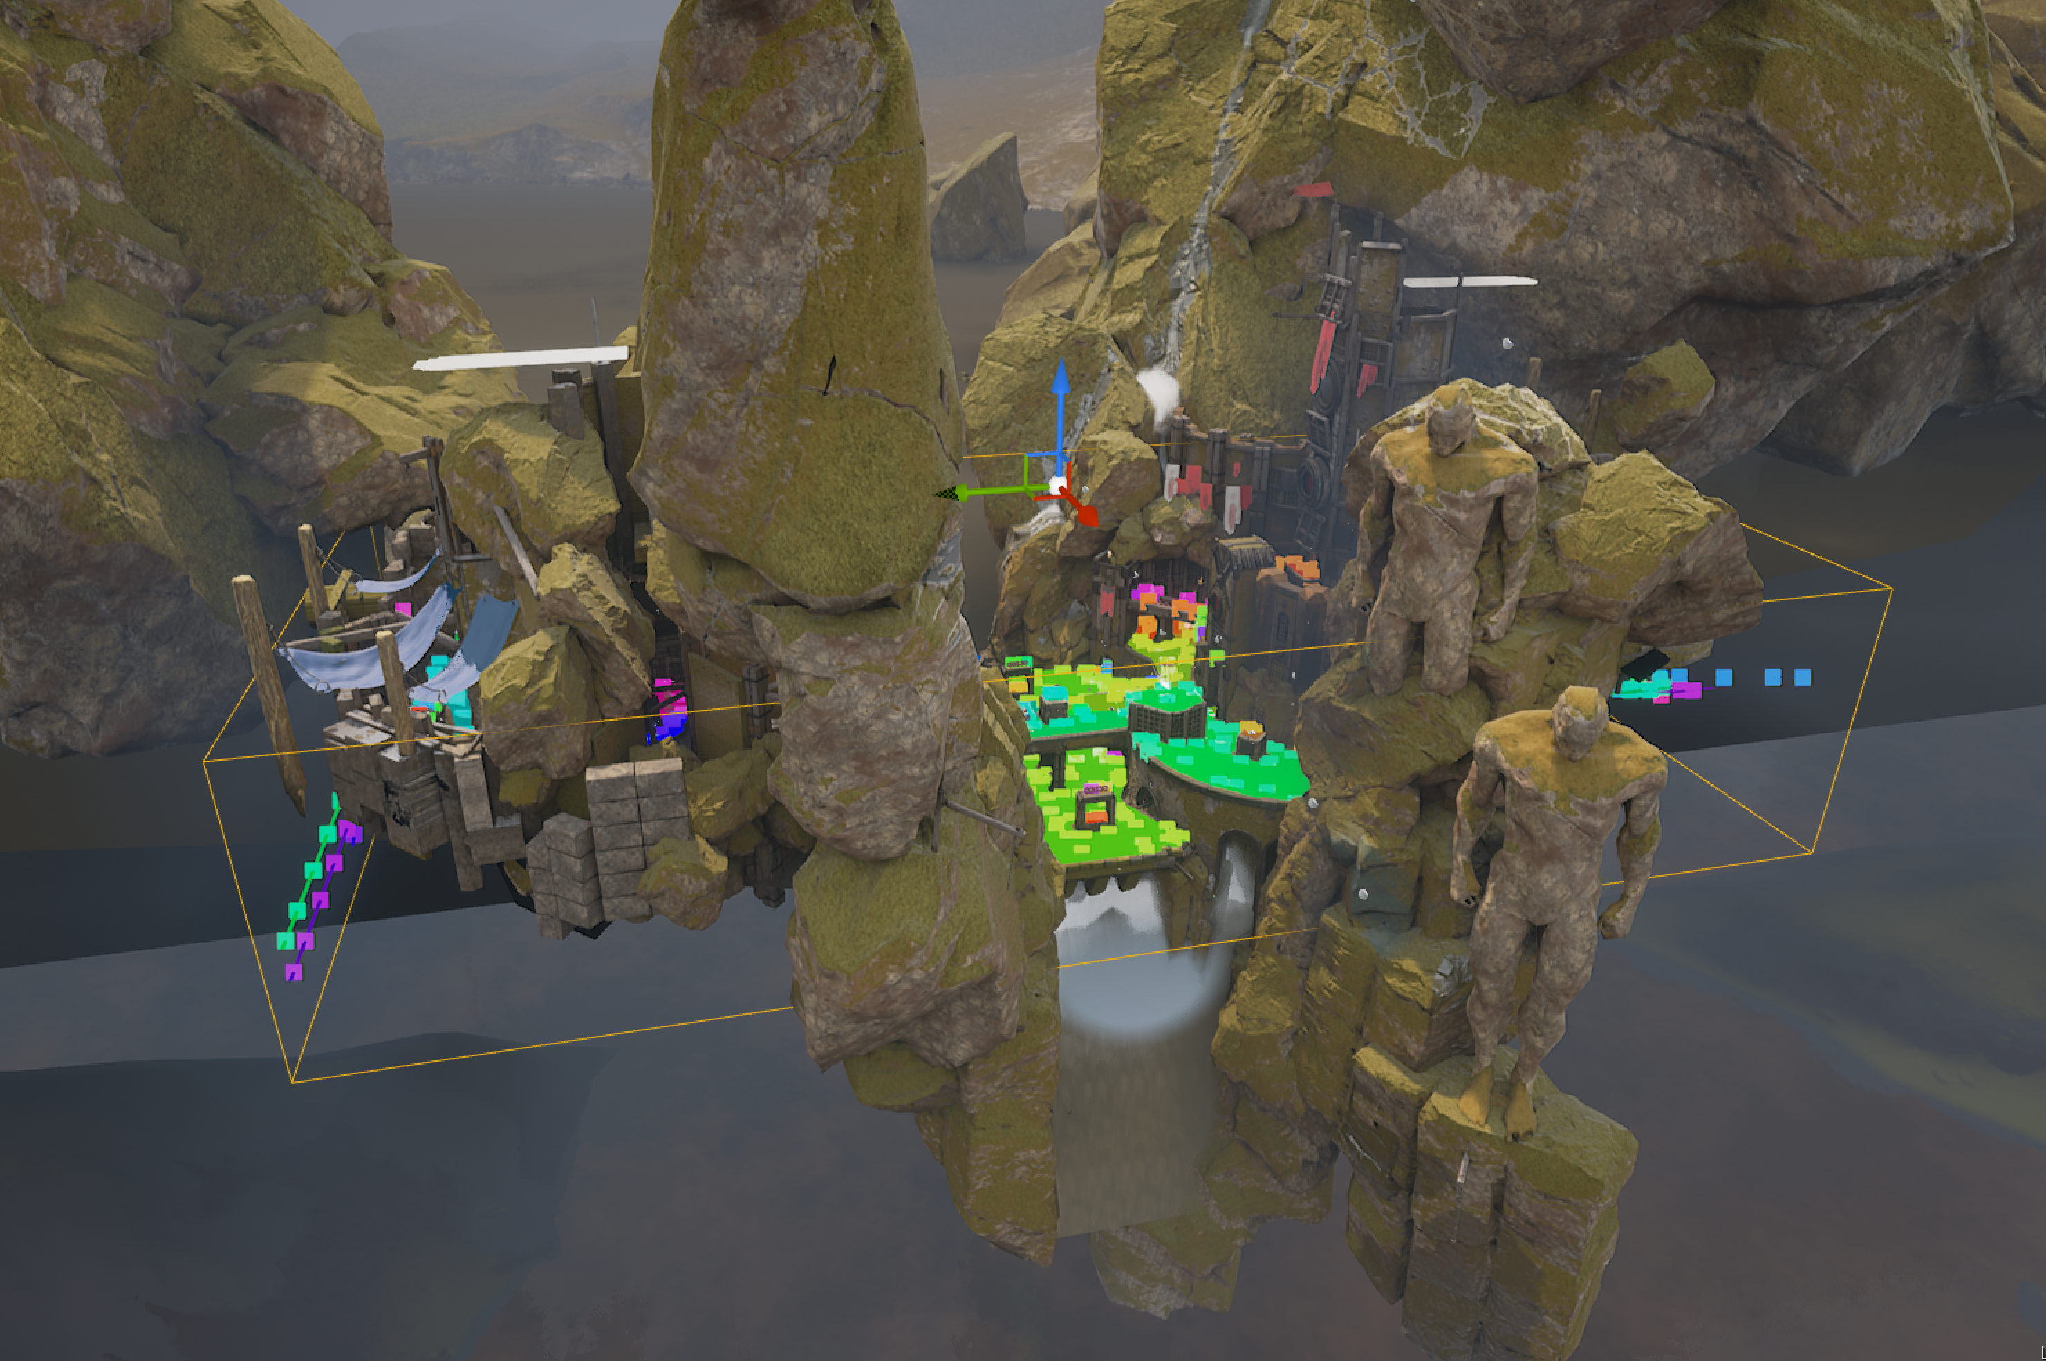
Setting up a Navmesh in Unreal
To set up a navigation mesh in Unreal Engine, add a NavMeshBounds Volume to your environment. If you enable Path Viewing (P), you should see large green regions covering the map to indicate what areas can and can’t be reached by AI within the environment.
By default the NavMesh is calculated against an agent that is roughly the size of a typical human. Additional Agents can be added from the Project Settings.
The Navmesh Bounds Volume calculates navigable areas in the map.

Slide 11
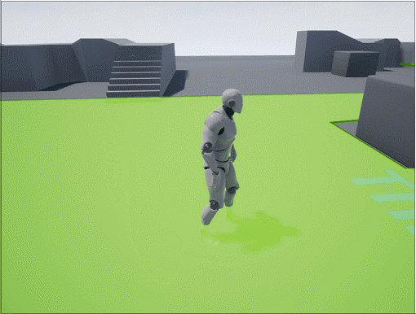
NavMesh Invokers
Navigation meshes are typically built automatically during level development; however, for large-scale environments, this can take up considerable resources.
A solution is the use of navigation invokers, where navigation is only built around Actors with a NavMesh Invoker Component. When two Actors with this component walk close to one another, their navigation regions connect.
The NavMesh is extended as the Player moves

Slide 12
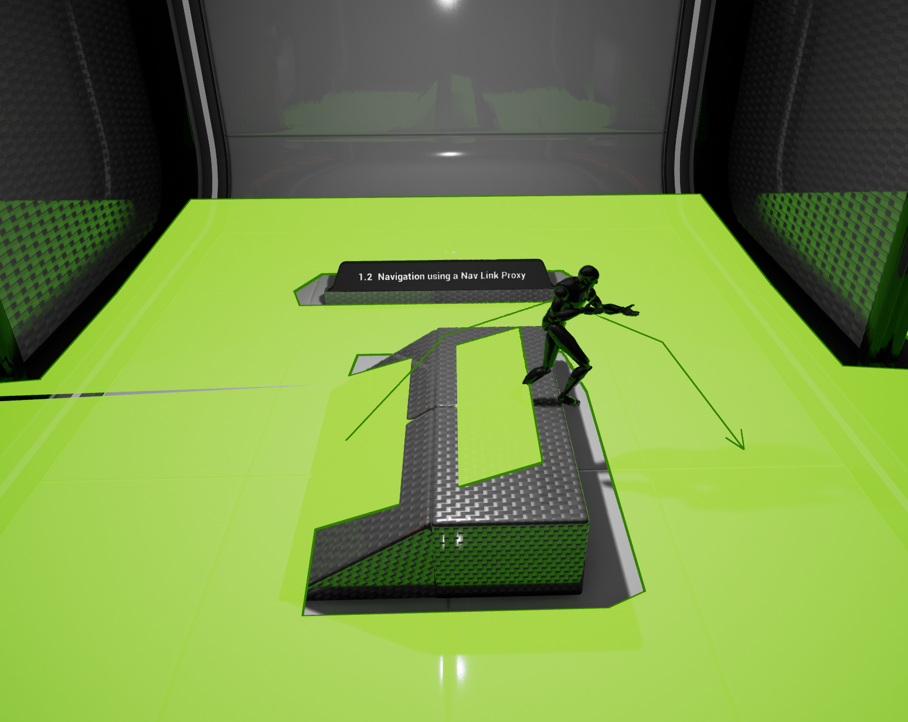
Navlink Proxy
Navigation Link Proxies are a way of connecting sections of NavMeshes that aren’t automatically connected through an automatic connection. They could be used for ledges, elevators, or other environmental quirks.
Navigation Link Proxys can be expanded with smart links to automatically trigger behaviors in Actors trying to cross them.
Content Examples: Nav Mesh

Slide 13
AI Imperfection
Making Things Seem Normal,
Even When They’re Not

Slide 14

Cheating AI
Since AI is a part of the game, it has the potential to know any Actor’s properties at any given time. Because of this ability, it’s almost impossible for the AI in a game to not in some way “cheat.” That said, while AI can see the whole board, there are many qualities of human players that AI typically lacks, such as intuition, natural understanding of play styles, and adaptability outside of its given instruction set.

Slide 15
Known Friendlies
It’s common for AI to know where its friends are but to rely on a given perception system to detect enemies. The first method of developing around known friendlies is to limit perception of friendly AI to a controlled field of vision. Players are unlikely to know where enemies are at any given time, so they are unlikely to spot this semi-omniscient behavior.
Known Environment Layout
In almost all cases, AI is informed of its environment layout. Unlike players, who may look at a bridge and ask “How do I get there?” the AI is almost always informed of how to reach any given location that is reachable.
Key Item Locations
Since the perception of being “reactionary” is important, game items like flags and power-ups often have their positions known to the AI at any given time. This means that when a key event occurs, the enemies in a game are able to react to it intelligently instead of relying on perception.
Full Player Comprehension
AI often keeps a list of references to any known/perceived enemies. This list is updated when a player is seen, and when the AI has lost sight of a player there is typically an amount of time that the player and their actions continue to be tracked before the player is removed from the list. This means that the AI has a better general sense of permanence of threats in the area; it also means that it can know where the player is aiming or what they’re doing despite not having a direct view of them.
The enemy can cheat, but you probably won’t know.

Slide 16
Artificial
Stupidity
If an enemy were to open fire on a player and fire according to the information at its disposal, with an instant-hit weapon the enemy wouldn’t miss. With a projectile weapon it is very unlikely that the enemy would miss. Since AI is driven by variables and can instantly process almost any Actor in the game, its logic and aim are often intentionally compromised to allow for a fighting chance by players.
These intentional decreases in ability can occur in a variety of ways, including but not limited to the following:
Artificial delays on information to simulate human reaction times
Enemy AI missing its shots when first entering combat with a player to give the player time to react and head to cover
Enemies decreasing in accuracy as a player reaches low health to help encourage battles that the player only just survives

Slide 17
Perceiving Intelligence
Part of intelligent behavior seeming intelligent is signaling intent to the player. When an enemy appears to have planned or coordinated its behavior, it appears to be drawing information from realistic sources and coordinating its actions as one would expect real players to do. This signaling can be done in various ways.
For instance, if an AI unit is in the process of approaching the player from the side, it may pass information to another AI player to shout out “Flank them!” to imply that the setup was intentional.

Slide 18
AI Directors
AI can be wider reaching than a conventional game agent and used to direct a large number of game enemies or game events. An AI Director could be telling hordes of enemies which players to attack, identifying how to set up tense situations for players as they move through a level, or even determining how to add health and weapons for players so that they can feel like they’re just surviving by the skin of their teeth.
Player Assisted Guidance
AI can be used so that if a player gets lost, lights or other world aspects are triggered in a way that directs their attention toward the correct path. A more obvious way to do this is with nearby non-playable characters adding conversation elements that suggest the player move toward a goal.
Procedural Generation
AI can be used for a wide range of elements involved in procedural generation. For instance, AI could be used to intelligently automatically grow a forest with certain foliage types according to specific growth and distribution rule sets.
Game Balancing
AI can be used for automatic game balancing. By developing AI that is tracking how the player is playing the game, how erratic their movements are, or how they typically do in different engagements, AI could be used to make the game more or less difficult dynamically.
AI beyond Agents

Slide 19
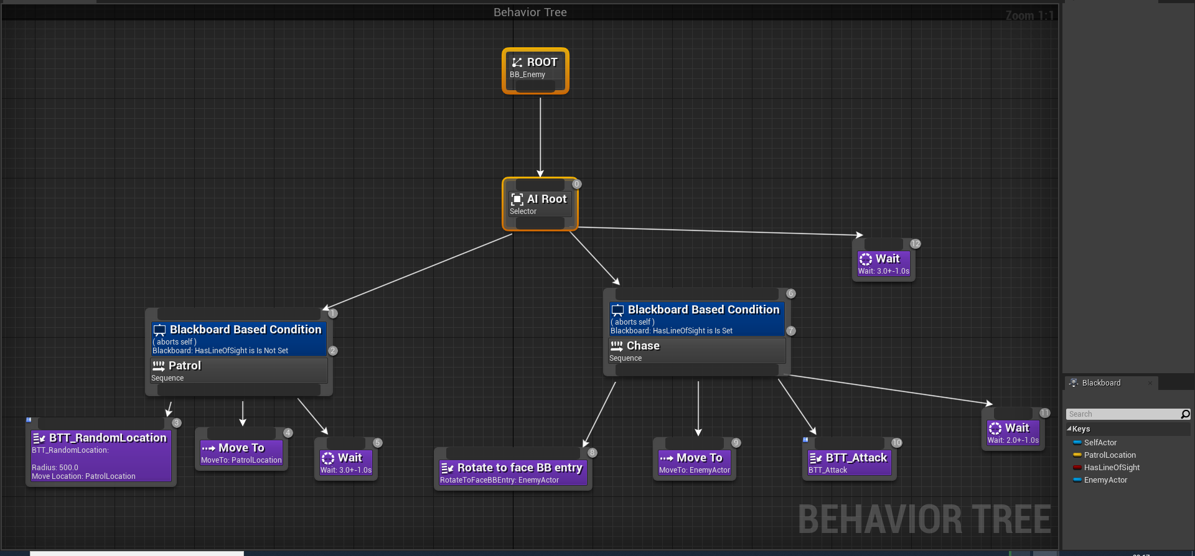
REQUIREMENTS:
Implement the behavior tree and blackboard setup below for BP_Enemy.
Create and Implement BTT_Attack.
Show it’s working with one BP_Enemy on the map.
Patrolling and chasing sequences should be stopped based on current Line of Sight to the player from the enemy.
HOMEWORK:
CHASING/PATROLLING AI
HINTS AND EXAMPLE STEPS:
https://docs.unrealengine.com/4.26/en-US/InteractiveExperiences/ArtificialIntelligence/BehaviorTrees/BehaviorTreeQuickStart

Slide 20
Conclusion
Questions?

